Slide 1

SRI CHANDRASEKHARENDRA SARASWATHI VISWA MAHAVIDHYALAYA
(Deemed to be university u/s 3 of UGC act 1956) (Accredited with “A” by NAAC)
Enathur, Kanchipuram – 631561. Tamilnadu www.kanchiuniv.ac.in
BCSF187Z50 - Project Work - Phase I
ASSET MANAGEMENT SYSTEM
11209A020 V Venkata Surya
11209M001 S Aravind
Guided By
MR V BALU
Assistant Professor
Department of CSE
University Review: 20/11/2024

Slide 2
ASSET MANAGEMENT SYSTEM
Abstract : In this project, we developed a system for effective management of asset for organizations to optimize their resources and streamline operations. This abstract introduces an innovative Asset Management System built on the MERN (MySQL, Express, React, Node) stack, designed to efficiently manage product data. This web-based solution offers a comprehensive approach. The system allows users to record, categorize, and monitor a wide array of products within an organization. Once the product is searched into the database it fetch the variants available for the product. Before fetching master has accesses to add products , variants, values etc .In react it offence more scalable dynamically
Keywords: Asset management , MERN stack , scalability , categorization , streamline operations , variants

Slide 3
ASSET MANAGEMENT SYSTEM
Introduction
The Asset Management System is a web-based application designed to streamline asset tracking and management within organizations. Developed using React.js for the front end and Node.js for the back end, the system ensures secure user authentication and authorization with role-based permissions. The intuitive dashboard provides a quick overview of asset status and distribution through visualizations and charts. Key features include comprehensive asset management and search capabilities. The technology stack incorporates React.js for its interactive UI and Node.js for its scalability on the backend. A relational database ensures data integrity. Overall, the system aims to enhance organizational efficiency by providing a user-friendly platform for managing assets, contributing to improved productivity and resource optimization.

Slide 4
ASSET MANAGEMENT SYSTEM
Problem Statement: In today's rapidly evolving business landscape, the efficient management of asset is more importance to organizations seeking to optimize resource allocation and streamline their operations. Despite the significance of effective asset management, many organizations face challenges in cataloging, monitoring, and categorizing their products. This often results in inefficient resource utilization and hinders decision-making processes.
To address this issue, we propose the development of an innovative Asset Management System built on the MERN (MySQL, Express, React, Node) stack. The primary problem that this system aims to solve is the lack of a robust and comprehensive solution for managing product data effectively.

Slide 5
ASSET MANAGEMENT SYSTEM
Existing system and its drawbacks:
The existing systems for asset management in many organizations often suffer from several drawbacks, hindering their effectiveness in optimizing resources and streamlining operations.
Manual data Entry
Limited Accessibility
Lack of Real- Time Updates
Inadequate Categorization And Search

Slide 6
ASSET MANAGEMENT SYSTEM
Literature survey
[1] Investigation: A Productive Asset Management Web Application Computer Systems Science & Engineering DOI:10.32604/csse.2021.015314
[2] M Wang, J Tan, Y Li - 2015 IEEE international conference on …, 2015 - ieeexplore.ieee.org
[3] Markus Keinänen Creation of a web service using the MERN stack
[4] D Sarkar, H Patel, B Dave - … Journal of Construction Management, 2022 - Taylor & Francis
[5] L Turnip, A Triayudi , ID Solihati - Jurnal Mantik , 2020 - iocscience.org
Asset Management Information System Using the Waterfall Method (Case Study: National University)

Slide 7
ASSET MANAGEMENT SYSTEM
Proposed Method
In this we proposed Asset management using the MERN (MYSQL, Express.js, React.js, Node.js) stack for web development involves creating a system to efficiently track and manage assets within an organization
1)Database Design (MY SQL):
Asset Collection:
Create a MY SQL collection to store asset information. Each document in this collection represents a unique asset and includes fields such as asset id, name, variants, purchase value data, etc.
2) Backend Development (Node.js and Express.js):
API Endpoints:
Implement RESTful API endpoints using Express.js to perform CRUD operations on assets.
Middleware:
Implement middleware for user authentication and authorization to ensure that only authorized users can access certain endpoints.

Slide 8
ASSET MANAGEMENT SYSTEM
3) Frontend Development (React.js):
User Interface:
Develop a user-friendly interface using React.js to interact with the asset management system.
Create components for listing assets, adding new assets, updating existing assets, etc.
State Management:
Utilize state management libraries like Redux to manage the application's state, especially if the application grows in complexity.
4) Integration &User Authentication and Authorization:
Connect the React.js frontend with the Node.js backend through API calls.
Implement Authentication:
Use a secure authentication method (e.g., JWT) to authenticate users.

Slide 9
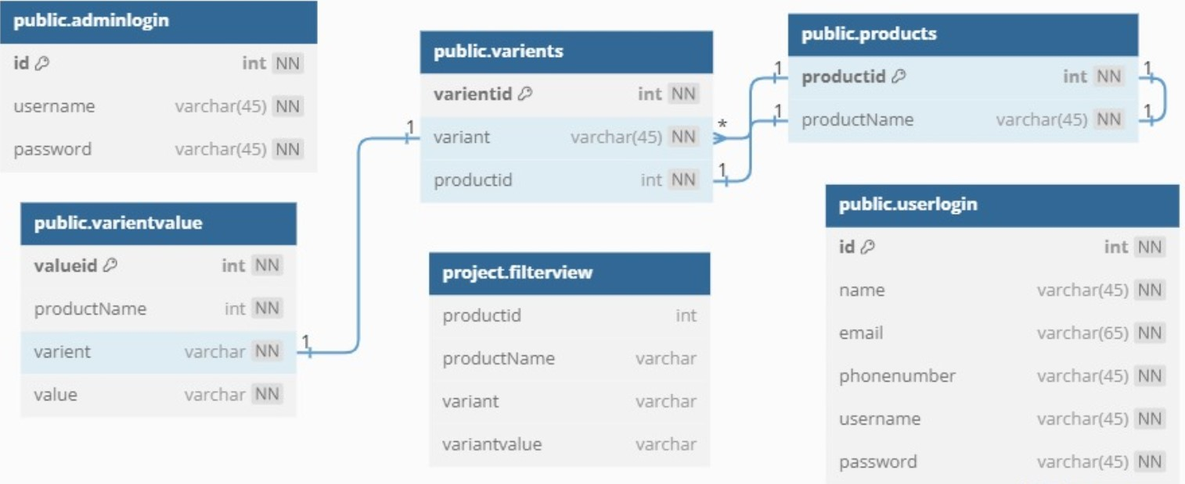
Database Design
ASSET MANAGEMENT SYSTEM

Slide 10
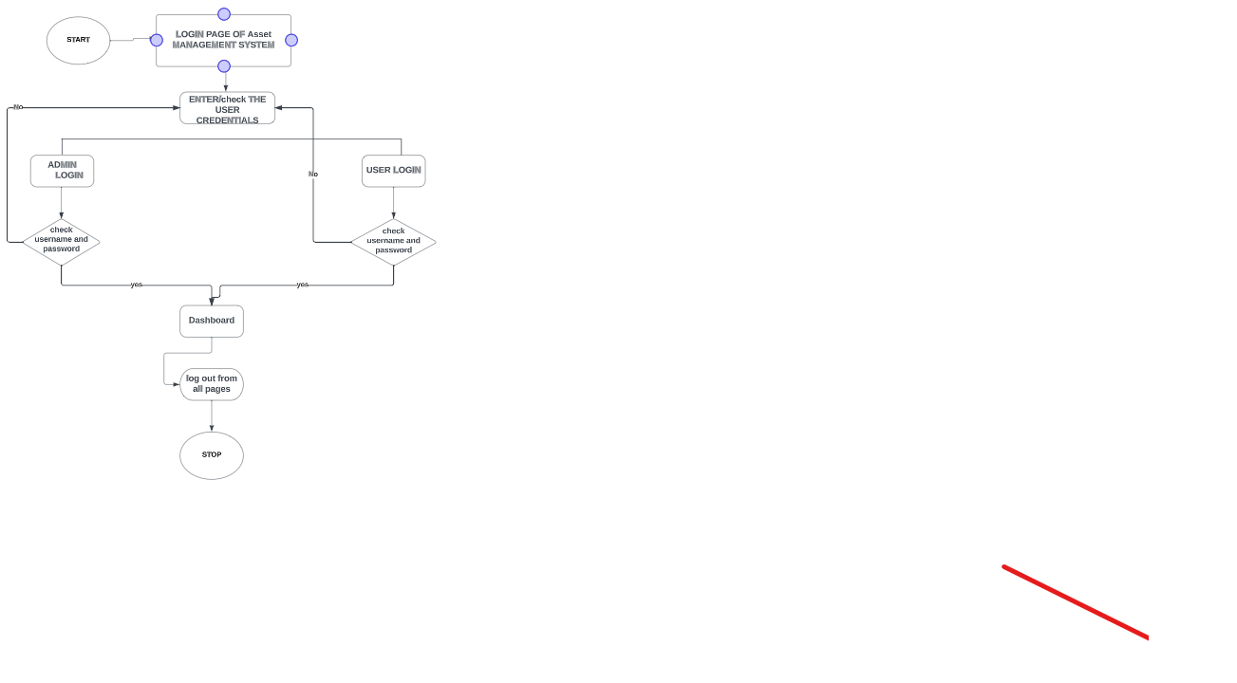
Architecture Diagram
ASSET MANAGEMENT SYSTEM

Slide 11
ASSET MANAGEMENT SYSTEM
Project Description
The Asset Management System is a web-based application designed to streamline and optimize the management of assets within an organization. Developed using React.js for the front end, Tailwind for designing, Node.js and Express for the backend, and MySQL for the database. This system provides a user-friendly interface for efficient asset tracking, variant management, and purchase transactions.
Key Features: The system offers a secure and intuitive login mechanism, allowing authorized users to access and manage assets seamlessly. Users can add new assets with different variants, and assign specific values to each variant. The ability to delete variants provides flexibility in adapting to changing organizational needs. The search functionality lets users quickly locate specific assets, enhancing overall accessibility.

Slide 12
ASSET MANAGEMENT SYSTEM
Purchase Functionality: One of the core functionalities is the purchase feature, where users can select and purchase products with their respective variants by simply checking the desired options. This streamlined process not only simplifies procurement but also ensures accuracy in the selection of products and their variants.
Technological Stack: The project utilizes a modern and efficient technological stack. React.js provides a dynamic and responsive user interface, while Node.js and Express establish a robust backend connection. MySQL serves as the database, ensuring data integrity and reliability. The integration of these technologies creates a scalable and maintainable system capable of meeting the evolving asset management needs of the organization.
In the Asset Management System enhances organizational efficiency by offering a centralized platform for managing assets, variants, and purchase transactions. Its user-friendly interface, coupled with the power of React.js, Node.js, Express, and MySQL, makes it a versatile and indispensable tool for any organization seeking to optimize its asset management processes.

Slide 13
ASSET MANAGEMENT SYSTEM
Module Description
User Authentication Module: The User Authentication module forms the foundation of the system, ensuring secure access to the Asset Management System. This module includes user registration, login, and authentication mechanisms. User credentials are securely stored and managed, allowing only authorized personnel to interact with the system.
Asset Management Module: The Asset Management module facilitates the addition and categorization of assets within the organization. Users can input details such as asset name, type, and description. Additionally, this module supports the creation of variants for each asset, providing a structured approach to managing different versions or configurations of a particular asset.

Slide 14
ASSET MANAGEMENT SYSTEM
Variant Management Module: This module focuses on the creation, modification, and deletion of variants associated with each asset. Users can define specific attributes and values for each variant, tailoring the system to accommodate diverse asset specifications. The ability to delete variants ensures adaptability to changing organizational requirements.
Purchase Transaction Module: The Purchase Transaction module streamlines the procurement process by allowing users to select and purchase products along with their specified variants. Users can easily navigate through available assets, select desired variants via checkboxes, and proceed with the purchase. This module ensures accuracy and efficiency in the procurement of assets.

Slide 15
ASSET MANAGEMENT SYSTEM
Methodology
Requirements Analysis:
Objective: Clearly define the goals and functionalities of the Asset Management System.
Activities: Engage with stakeholders to gather and document detailed requirements. Identify key features, user roles, and system constraints.
2. System Design:
Objective: Create a blueprint of the system architecture and design the database schema.
Activities: Design the user interface (UI) using wireframes or mockups. Plan the database structure, considering entities, relationships, and data flow.
3. Technology Stack Selection:
Objective: Choose the appropriate technologies for frontend, backend, and database.
Activities: Evaluate and select technologies based on project requirements, scalability, and the development team's expertise. React.js for the front end, Node.js, Express for the backend, and MySQL for the database.

Slide 16
ASSET MANAGEMENT SYSTEM
Implementation:
Objective: Develop the system according to the design and requirements.
Activities: Start by setting up the project structure. Implement each module iteratively, beginning with user authentication, asset management, and so on. Regularly test and debug as new features are added.
Testing:
Objective: Ensure the system functions correctly and meets requirements.
Activities: Conduct unit testing for individual modules, integration testing to ensure components work together, and system testing to verify the entire application. Address any issues discovered during testing.

Slide 17
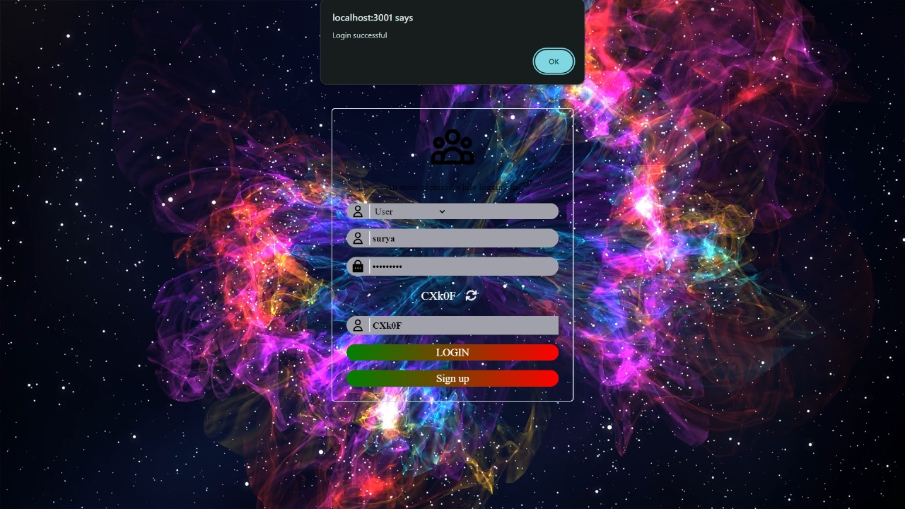
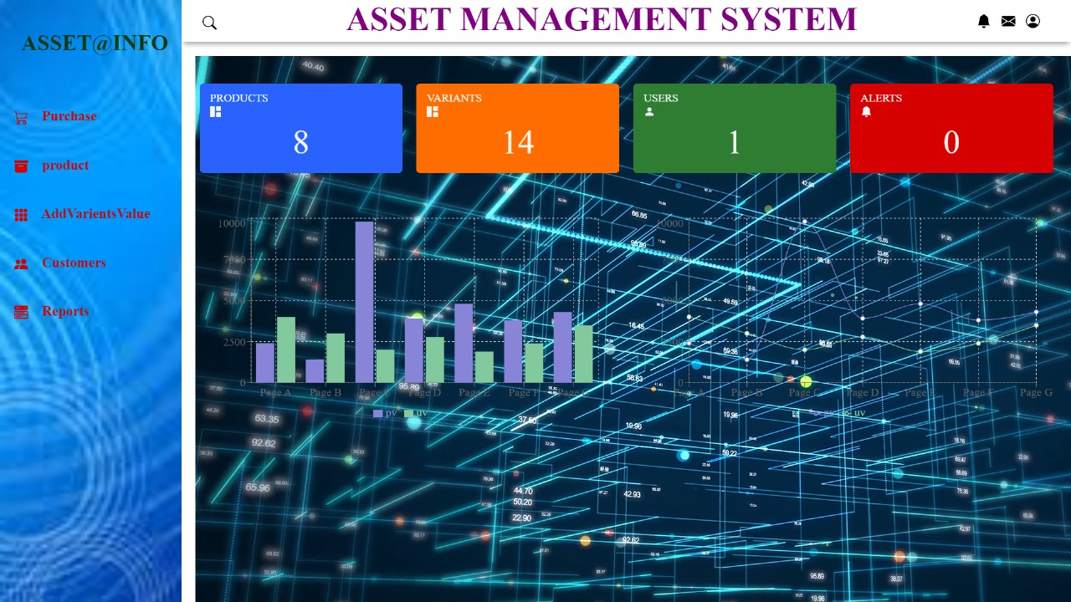
Results
ASSET MANAGEMENT SYSTEM

Slide 18
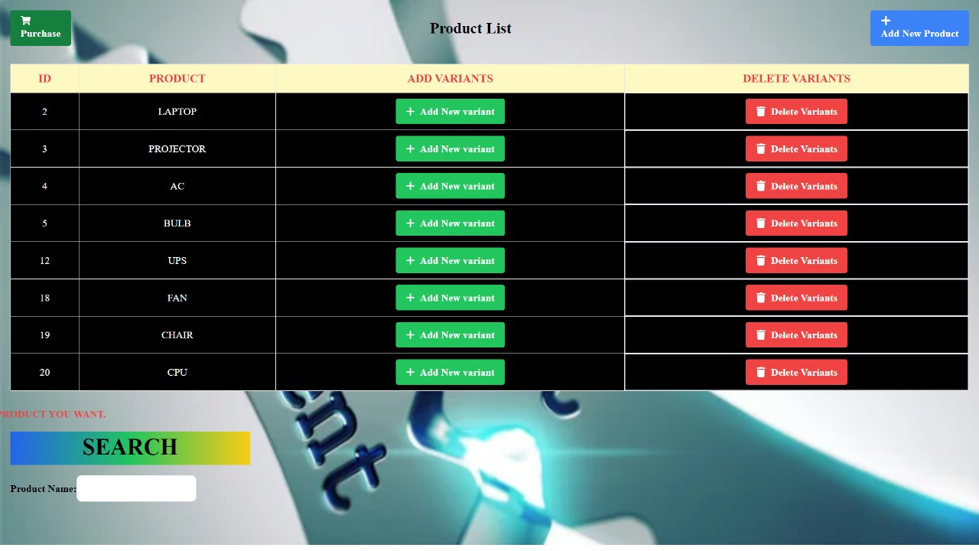
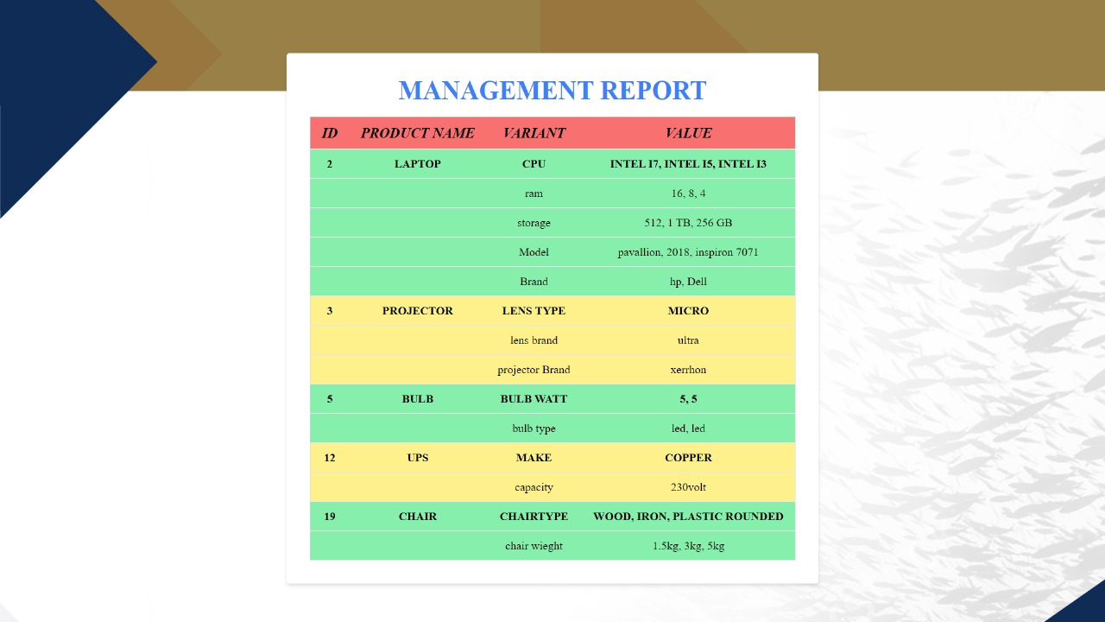
ASSET MANAGEMENT SYSTEM

Slide 19
Conclusion
ASSET MANAGEMENT SYSTEM
The Asset Management System project has successfully implemented a user-friendly solution using React.js, Node.js, Express, and MySQL. With modules for user authentication, asset and variant management and efficient search capabilities, the system provides a comprehensive platform for seamless asset tracking. The deployment-ready application showcases a modular design, data accuracy, and scalability. As we move towards implementation, the Asset Management System is poised to enhance operational efficiency, offering a robust solution to meet the evolving asset management needs of our organization.

Slide 20
Future Enhancement
ASSET MANAGEMENT SYSTEM
In our roadmap for future enhancements, we prioritize the application with advanced search filters. Another significant upgrade includes the capability to add images to product profiles, providing a visual dimension to asset management. Recognizing the increasing demand for on-the-go access, we are exploring the development of a mobile compatibility, offering users the flexibility to manage assets from their smartphones.

